Slide 1
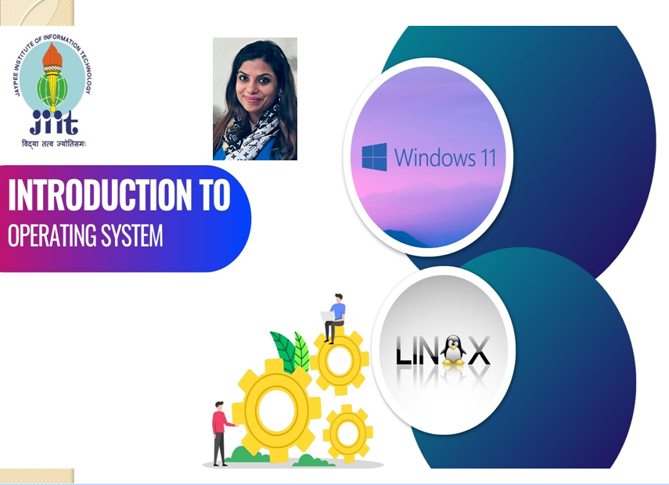

Slide 2
RECAP
What is an Operating System?
Computer System Components
Parts of OS
Goals for design
Functions
Why should I study Operating Systems?
Operating System Spectrum

Slide 3
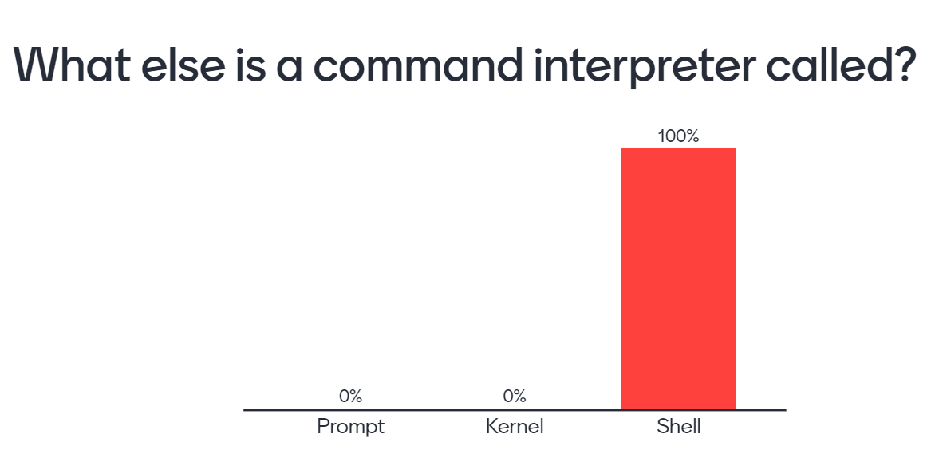
QUIZ

Slide 4
PREVIEW
Different types of Operating Systems.
OS structure
Monolithic vs. Microkernel OS

Slide 5
Types of Operating Systems
Batch Systems
Multi-Program
Time Sharing
Real Time
Embedded
Distributed /
Clustered

Slide 6
Batch Systems
In early days, computers ran from a Console.
Tape drivers or Card readers used for input.
Punch cards and Line printers used for output.
Grouped jobs that perform similar functions.
Jobs executed in Batches.

Slide 7
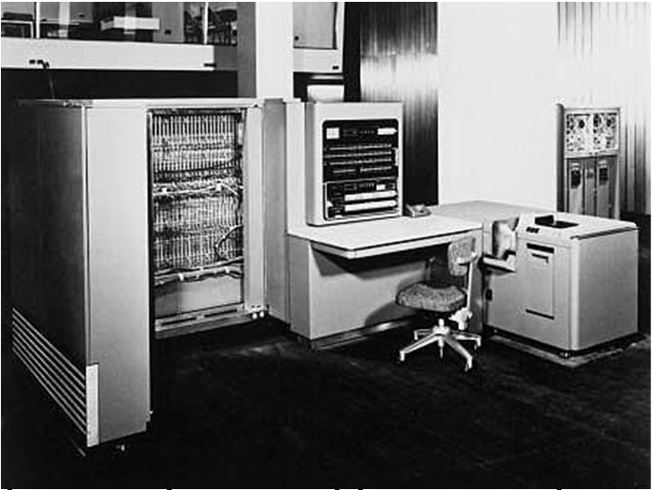
Old Times !!!

Slide 8
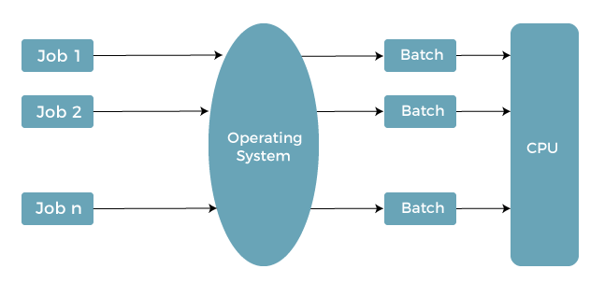

Slide 9
Operator Control
User submits job on card deck.
Cards put on tape.
Tape processed by operator.
Output written to tape.
Tape printed on printer.

Slide 10
Advantages
Manage large jobs.
No user interaction.
Improved CPU utilization.
Disadvantages
No direct interaction between user and system.
Full knowledge of batch systems needed.
Long turnaround time .
Low CPU utilization.

Slide 11
Multi-Programmed Systems
Run many programs on a single processor computer.
Execute another program while running program perform I/O.
Various jobs share CPU time.
Non- Preemptive.
Primary goal - CPU should never be idle.

Slide 12
TYPES
MULTI-TASKING
Execution of two or more programs at the same time.
MULTI-USER
Many users share processing time on a central computer.
Temporarily saved on disk
Different users from different terminals

Slide 13
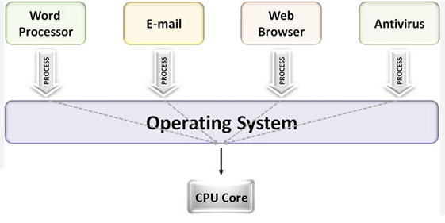
Multiple processes running

Slide 14
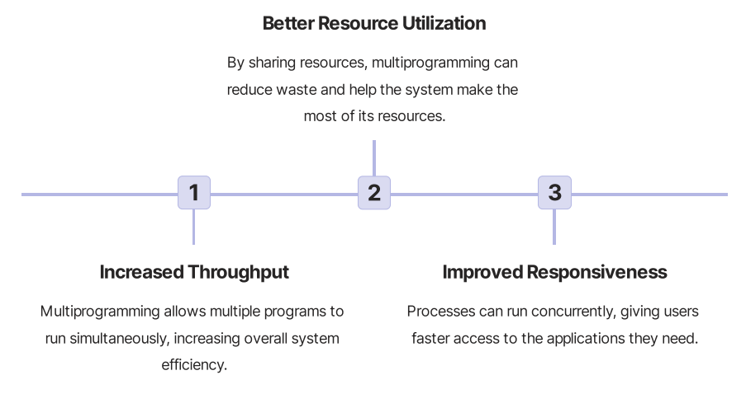
Advantages

Slide 15

What will be the DISADVANTAGES of multi-programming systems ?
It is highly complicated.
CPU scheduling is required.
Memory management is needed.
Long-term jobs will require a long wait.
All of these.

Slide 16

DISADVANTAGES of multi-programming systems
It is highly complicated.
CPU scheduling is required.
Memory management is needed.
Long-term jobs will require a long wait.
All of these.

Slide 17
Time Sharing Systems
Logical extension of multi-user multi-programming.
Fixed time slice for the different processes.
Timer device interrupts after a quantum (time slice).
Time quantum is minimal around10-100 milliseconds.
Switching between the process is very fast.
Preemptive.
Primary goal - Minimize response time.

Slide 18
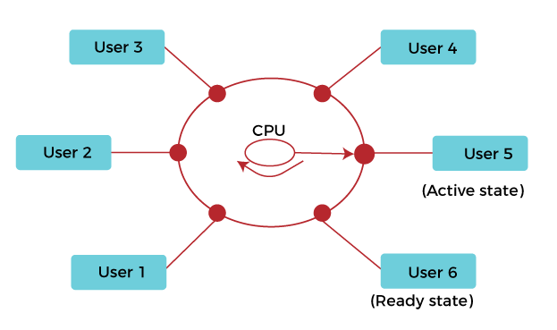
t3
t4
t2
t5
t1
t6
Multiple processes with time slices

Slide 19
Advantages
Multiple online users can use the same computer at the same time.
End-users feel that they monopolize the computer system.
Provides a quick response.
Last task doesn’t have to wait till end to get processor.
Disadvantages
Consumes many resources.
Requires high specification hardware.
Risk of data mixing.
Problem of reliability.

Slide 20
Real Time OS
A Real-Time Operating System (RTOS) is intended to allow a specific set of operations to be completed within a pre-determined interval of time.
Ex- MTS, Lynx, QNX, VxWorks etc.
Safety-Critical Systems
Deterministic Operation
Minimal Overhead

Slide 21
TYPES
HARD RTOS
Need to complete tasks by a given deadline
SOFT RTOS
Few delays in time duration are acceptable
EX- Pacemaker
EX- Telephone Switches, VR

Slide 22
Advantages
Easy to layout, develop and execute real-time applications.
Require much less memory space.
Size of programs is small, can be used in embedded systems like in transport.
Disadvantages
Very costly to develop.
Very complex
Consume critical CPU cycles.

Slide 24
Time Sharing Systems
Logical extension of multi-user multi-programming.
Fixed time slice for the different processes.
Timer device interrupts after a quantum (time slice).
Time quantum is minimal around10-100 milliseconds.
Switching between the process is very fast.
Preemptive.
Primary goal - Minimize response time.

